Slide 1
Content
ML System Architecture & a dummy microservice
Process flow automation & CI/CD
Data
Extraction
Inferencing
Typical ML Solution Architecture
ML Microservices dummy use case:
Problem Statement
Modelling Technique
Inferencing
Questions!
Data
Preparation
AI/ML Code
Orchestration
Serving Infrastructure
Data verification & QC
Deployment
Performance & Drift Monitoring
Analysis & Insight generation
Model registry &
versioning
Amardeep Chauhan
6th March, 2022

Slide 2











Typical ML Solution Architecture
1. Setup workspace, environments, and configurations
ML Workspace
Development & Job Clusters
Libraries, Configurations, and Drivers
5. Retraining, basis:
Incremental data
Performance drift
Data drift
Databricks
Ecosystem
Model Training
ADLS (gen2)
Log Analytics
Model evaluation
Delta Lake
Experiment Logging & Model Registry
Data Storage
4. Publish Results
Data Storage
Azure Monitor
AKS
2. Model Building & Training Process
3. Deploy Model
Power BI
Containers
Publish & Monitoring
When ready
CPU
GPU
Dev
Stage
Prod
Compute environment

Slide 3
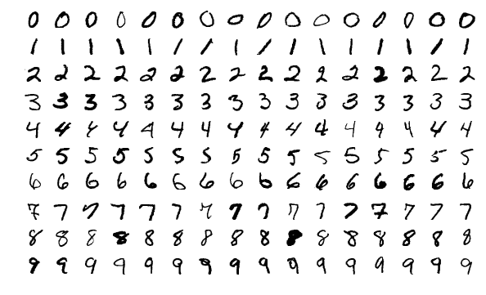
ML Microservices dummy use case Problem Statement
A simple & popular Digit Recognizer problem, where we try to solve the basic problem of recognizing the handwritten digits. It can also be expanded to recognize characters and various symbolic representations.
Recognizer & Classifier can build using:
K-Nearest Neighbour
Decision Tree
Support Vector Machine
Deep Neural Network
Convolution Neural Network

Slide 4
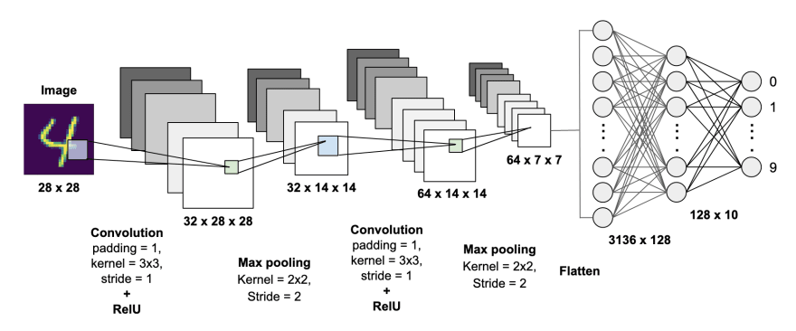
ML Microservices dummy use case Modelling Technique: Convolution Neural Network
CNNs are regularized and more optimized versions of multilayer perceptron.
CNNs are implemented on the human vision phenomenon, which means they show the sensibility when tested against various transformations such as scaling, translation, and rotations.

Slide 5
ML Microservices dummy use case Inferencing
Inferencing can be done in two ways:
Real-time Inferencing – Trained model is exposed to many parties and people wants to obtain on-demand predictions.
Batch Inferencing – Trained model is exposed to only one specific system, and that system fetches predictions in periodic basis, note that - it can also run on-demand.
Trained model performs only real-time inferencing and can be reached by below endpoint and request parameters:
Endpoint: localhost:8000/prediction
Response:
{
“filename”: "img_221.jpg",
“content_type”: "image/jpeg",
“prediction_probabilities”: // Predicted probabilities of all class labels,
“identified_number”: // Predicted Integer number based on the maximum class probability provided by the model
}
Request: {
“digi_image”: //upload image
}

Slide 6
Questions!!

